Slide 1
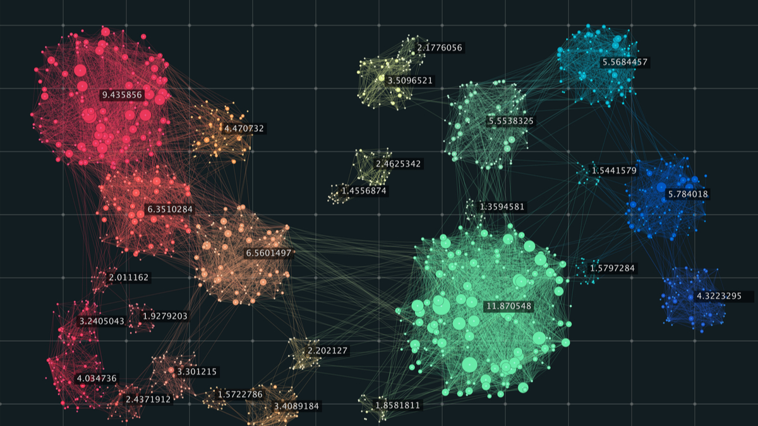
Spectral Clustering
Oriya Dahan, Adi Peisach

Slide 2
Graph Datasets
Vertices
Edges
Weights

Slide 3
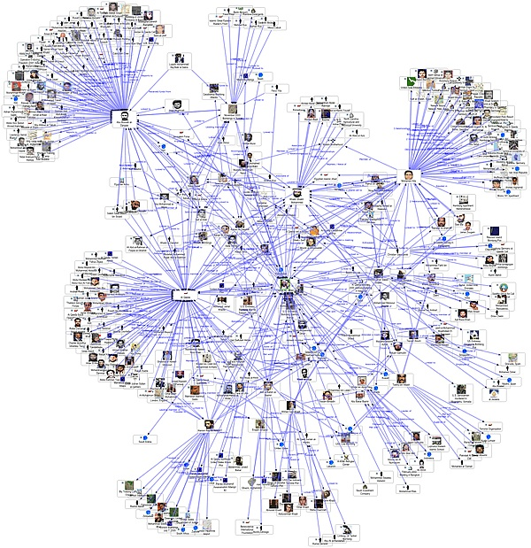
Graph Datasets
Social Networks
Vertices users
Edges connections (likes, follows…)
Weights number of likes

Slide 4
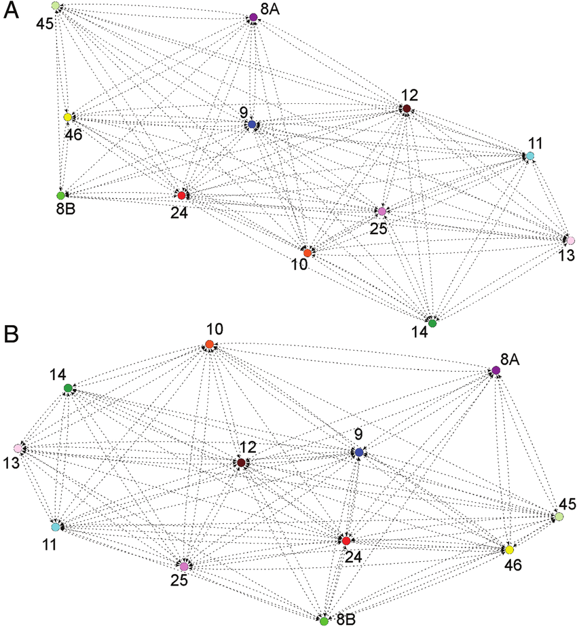
Graph Datasets
Social Networks
CryptoCurrency Transactions
Vertices traders
Edges transactions
Weights transferred amount

Slide 5
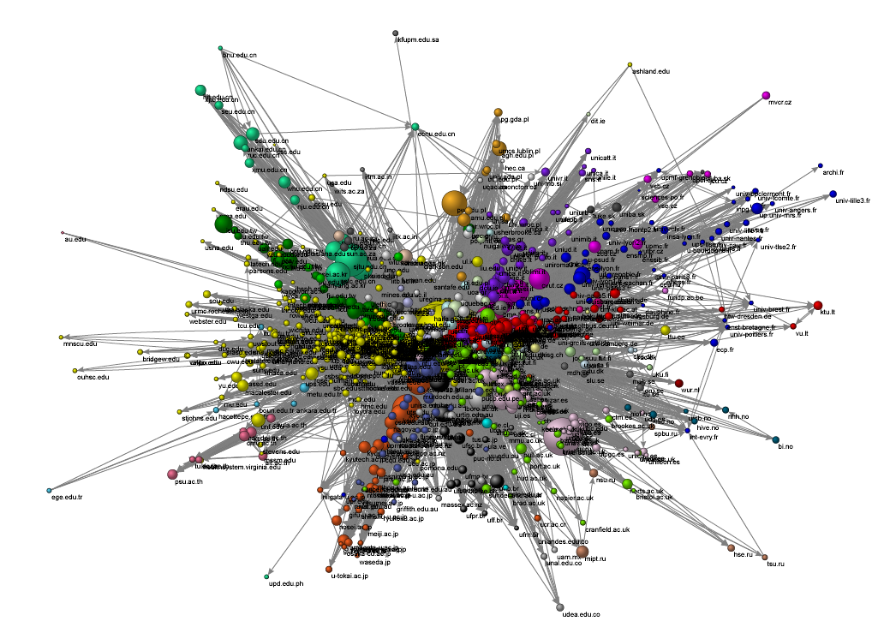
Graph Datasets
Social Networks
CryptoCurrency Transactions
Web Graph
Vertices websites
Edges links
Weights amount of links

Slide 6
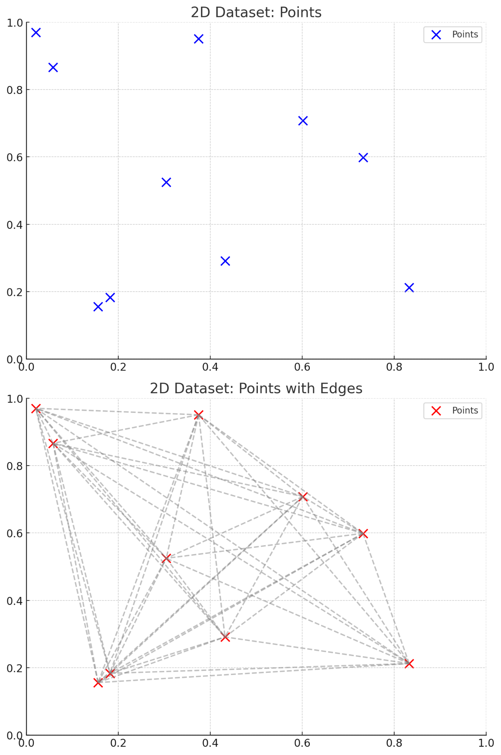
Graph Datasets
Social Networks
CryptoCurrency Transactions
Web Graph
Any dataset!

Slide 7
Graph Datasets
We can convert any data to a graph.
So how does it work?
Construct an adjacency matrix
Convert to similarity matrix

Slide 8
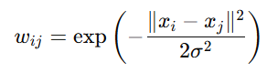
Graph Datasets
We can convert any data to a graph.
Fully connected

Slide 9
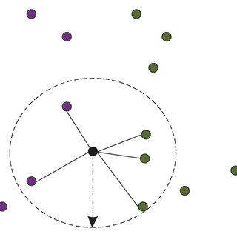
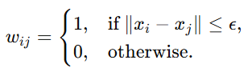
Graph Datasets
We can convert any data to a graph.
Epsilon Neighbourhood

Slide 10
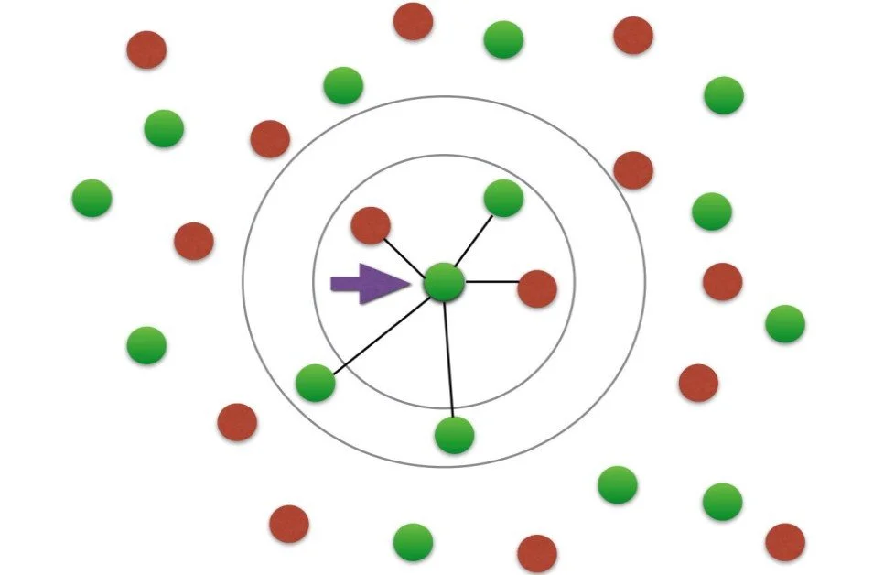
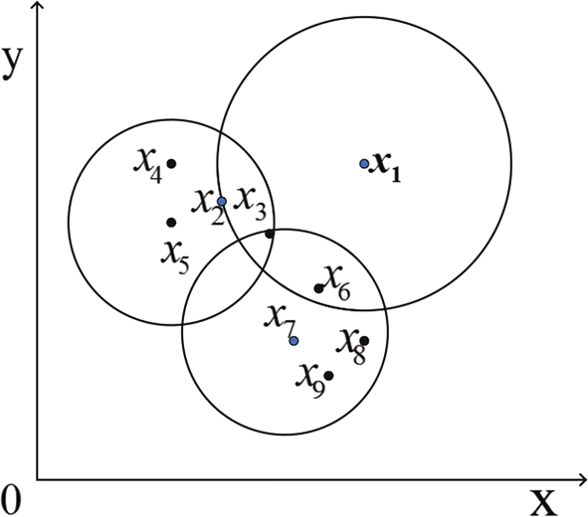
Graph Datasets
We can convert any data to a graph.
k Nearest Neighbours
Mutual k Nearest Neighbours

Slide 11
Our Dataset
Simple undirected weighted graph: G = (V, E, W)
Our Goal
Find communities/clusters in the graph

Slide 12
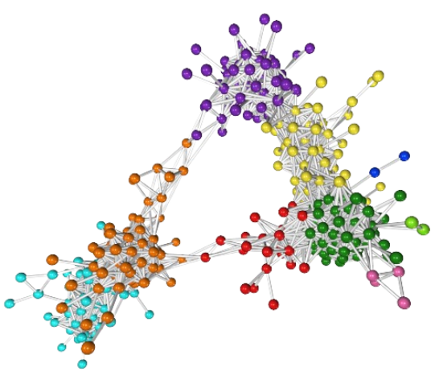
Our Objective
Strongly related nodes in the same cluster
Weakly related nodes in a different cluster

Slide 13
Our Objective
Maximize within-cluster weight
Minimize between-cluster weight

Slide 14
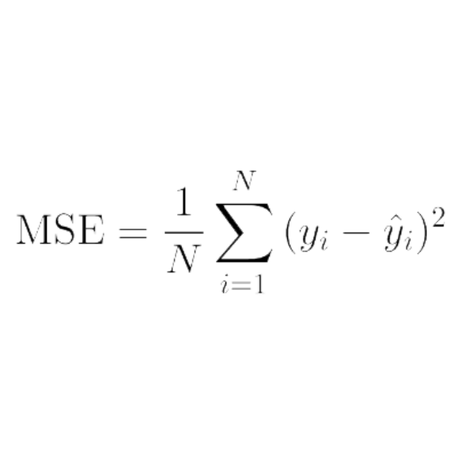
Objective Function
Minimizes the within-cluster distance
Doesn’t take into account between-cluster distance
Diminishes with k growing

Slide 15
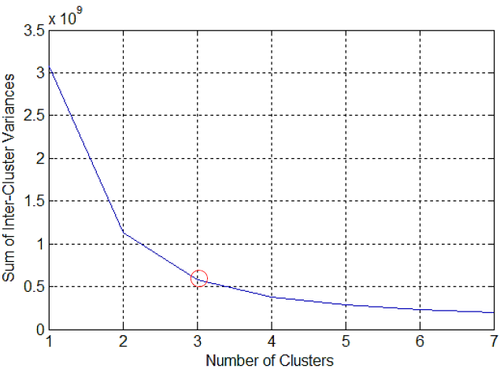
Objective Function

Slide 16
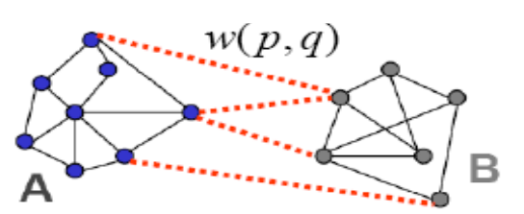
Objective Function

Slide 17
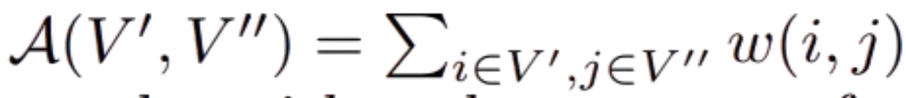
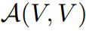
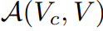
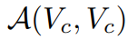
Objective Function - Definitions
= Sum of all weights in the graph (volume)
= Sum of all weights where at least one end is in C
= Sum of all weights where both ends are in C

Slide 18
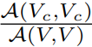
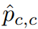
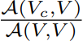
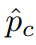
Objective Function - Definitions
=
Empirical probability of both ends of an edge being in C
=
=
Empirical probability of one end of an edge being in C
=

Slide 19
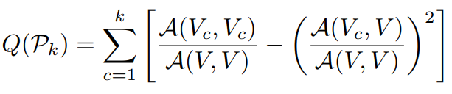
Objective Function
Maximize within-cluster weight
Minimize between-cluster weight

Slide 20
Objective Function - Edge Cases
A single cluster: blue is maximized (1), orange is maximized too (1)
Total: 0
A cluster for each node: blue is minimized (0), orange is minimized too (non-negative)
Total: ≤0

Slide 21
Objective Function - Edge Cases
3)
No edges between clusters: blue is maximized (1) orange is minimized.
Total: close to 1

Slide 22
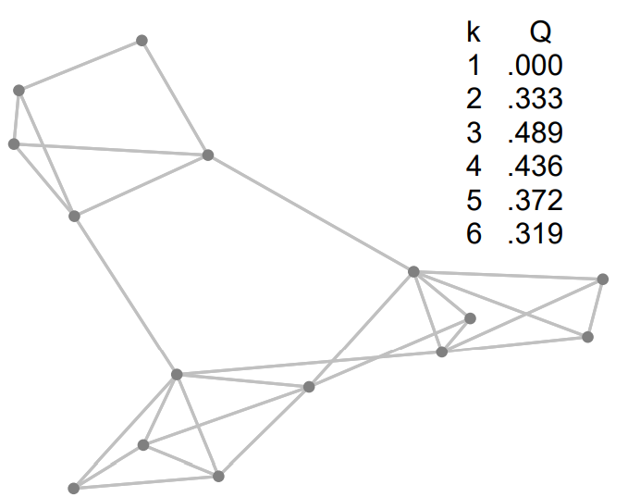
Objective Function - Example

Slide 23
Objective Function
Has been shown to correlate well with better clusterings.
In real world generally range from 0.3 to 0.7
Directly indicates the number of clusters

Slide 24
Approximation Problems
Reformulate the problem as a discrete problem. Might be NP-C.
Relax the problem to a continuous problem which is solvable.
Convert the continuous solution into a discrete solution efficiently.

Slide 25
Discrete problem
An assignment matrix is a binary n x k matrix representing the membership of data points to clusters.
Xij = 1, if the i-th data point is assigned to the j-th cluster,
0, otherwise.
{

Slide 26
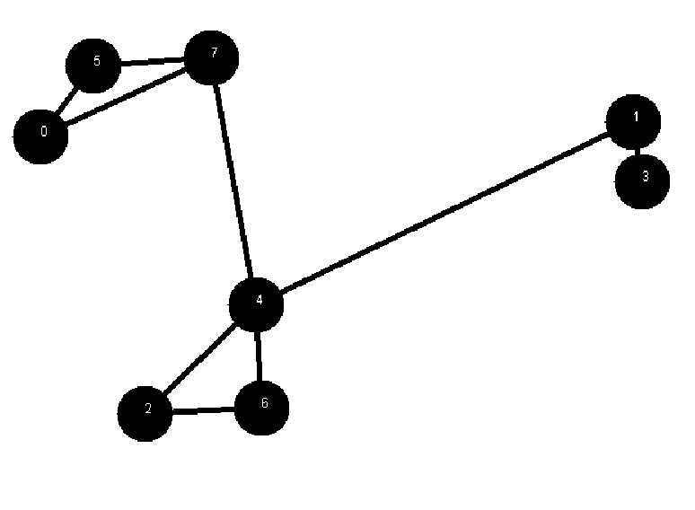
Discrete problem
1
1 2 3
0 1 0 0
1 0 1 0
2 0 0 1
3 0 1 0
4 0 0 1
5 1 0 0
6 0 0 1
7 1 0 0
2
3

Slide 27
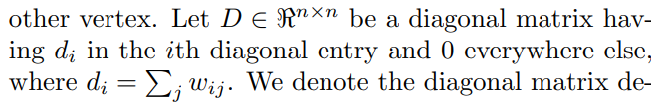
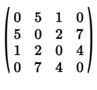
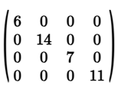
Discrete Problem

Slide 28
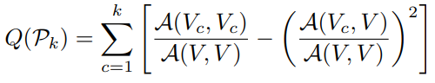
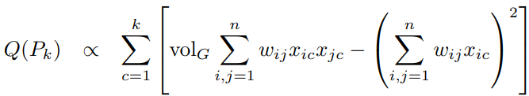
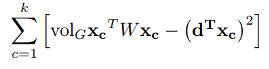
Discrete Problem
d := the diagonal of D matrix

Slide 29
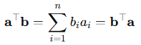
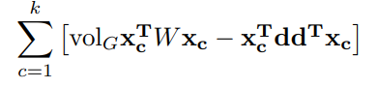
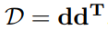
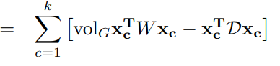
Discrete Problem

Slide 30
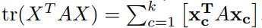
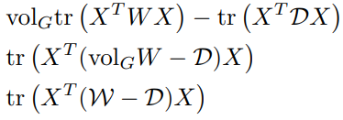
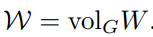
Discrete Problem

Slide 31
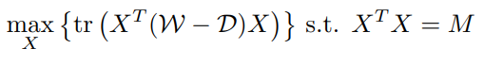
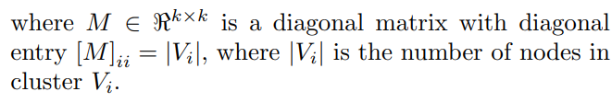
Discrete Problem
NP-Complete

Slide 32
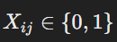
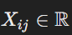
Spectral Relaxation

Slide 33
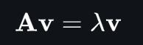
Eigenvectors and Eigenvalues

Slide 34
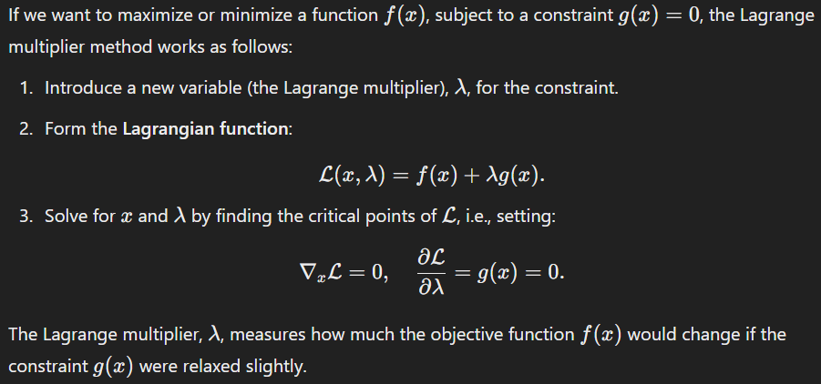
Lagrange Multipliers

Slide 35
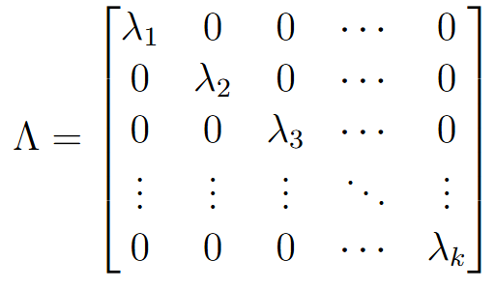
Lagrange Multipliers
Notes:
TODO: is it n here or k

Slide 36
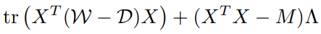
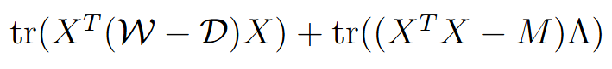
Lagrange Multipliers

Slide 37
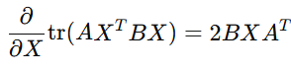
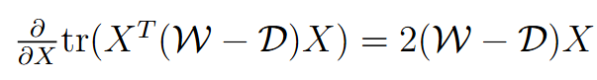
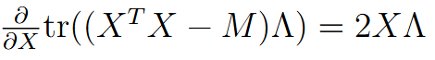




Lagrange Multipliers

Slide 38




Spectral Relaxation
We can solve using spectral decomposition!
I

Slide 39
Continuous solution Discrete solution
The Laplacian matrix encodes the differences in node connections across the graph.
What happens when we multiply the Laplacian with a node v?

Slide 40




Continuous solution Discrete solution

Slide 41


Continuous solution Discrete solution

Slide 42

Continuous solution Discrete solution

Slide 43

Continuous solution Discrete solution
The eigenvectors of capture the structure of the graph.
Their corresponding eigenvalues represent the variance.
Strongly connected nodes will have similar coordinates.
Taking the top k-1 eigenvectors gives us n nodes with k-1 features.
Use k-means!

Slide 44
The Algorithm

Slide 45




l²-norm

Slide 46

Algorithm

Slide 47
Time Complexity
K-means: O(ndke)
n := points
d := dimensions
k := clusters
e := iterations
Elkan’s K-means: O(nke)
O(n K² e)

Slide 48
REFERENCES
Algorithms that uses normalized cut:
M. Newman. Fast algorithm for detecting community structure in networks. Physical Review E, 69, 066133 (2004).
J. Shi and J. Malik. Normalized cuts and image segmentation. In IEEE Transactions on Pattern Analysis and Machine Intelligence, 22 (2000), pp. 888-905.
S. White and P. Smyth. Algorithms for discovering relative importance in graphs. In Proceedings of Ninth ACM SIGKDD International Conference on Knowledge Discovery and Data Mining, 2003, pp. 266-275.
Comparison algorithm and empirical results:
A. Ng, M. Jordan, and Y. Weiss. On spectral clustering: analysis and an algorithm. In Advances in Neural Information Processing Systems 14, 2002, pp. 849-856.
Elkan’s k-means:
C. Elkan. Using the triangle inequality to accelerate kMeans. In Proceedings of the Twentieth International Conference on Machine Learning, 2003, pp. 147-153.

